Slide 1
Lesson 6
Local descriptors and graph neural networks.

Slide 2
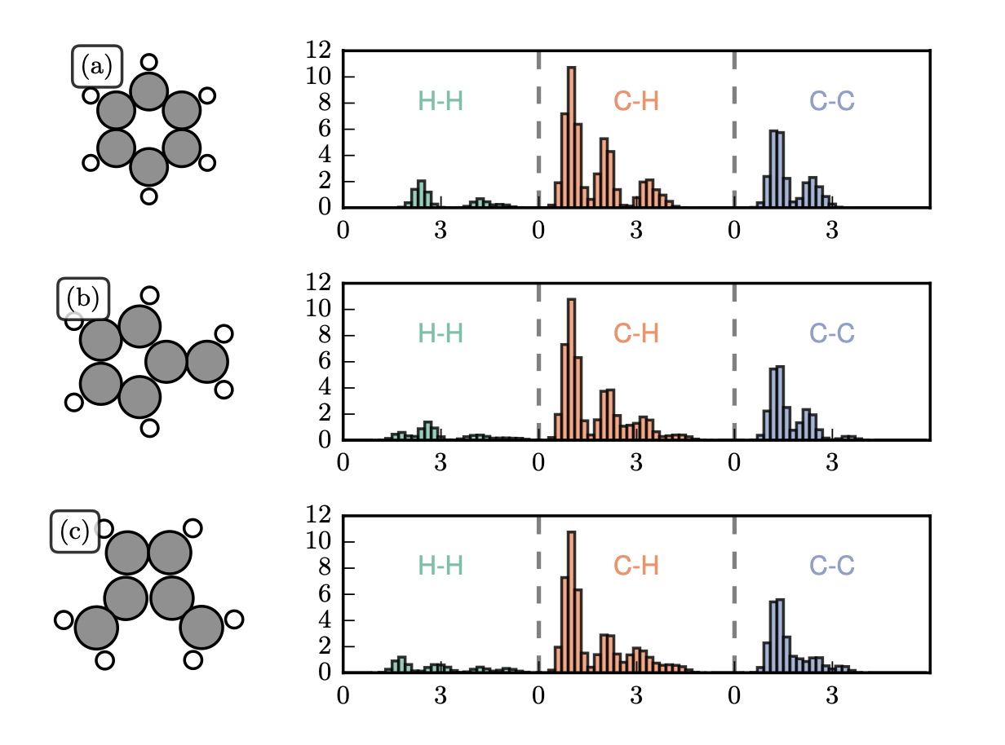
Global descriptors

Slide 3
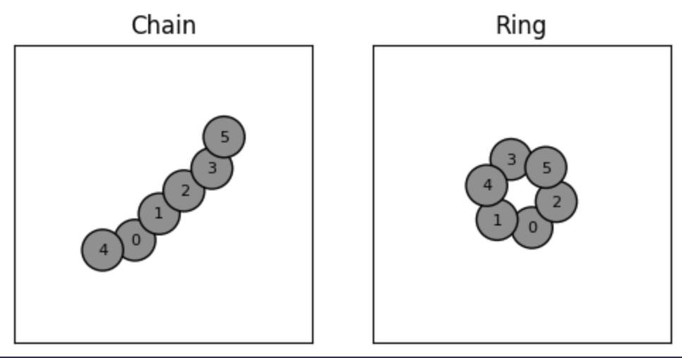
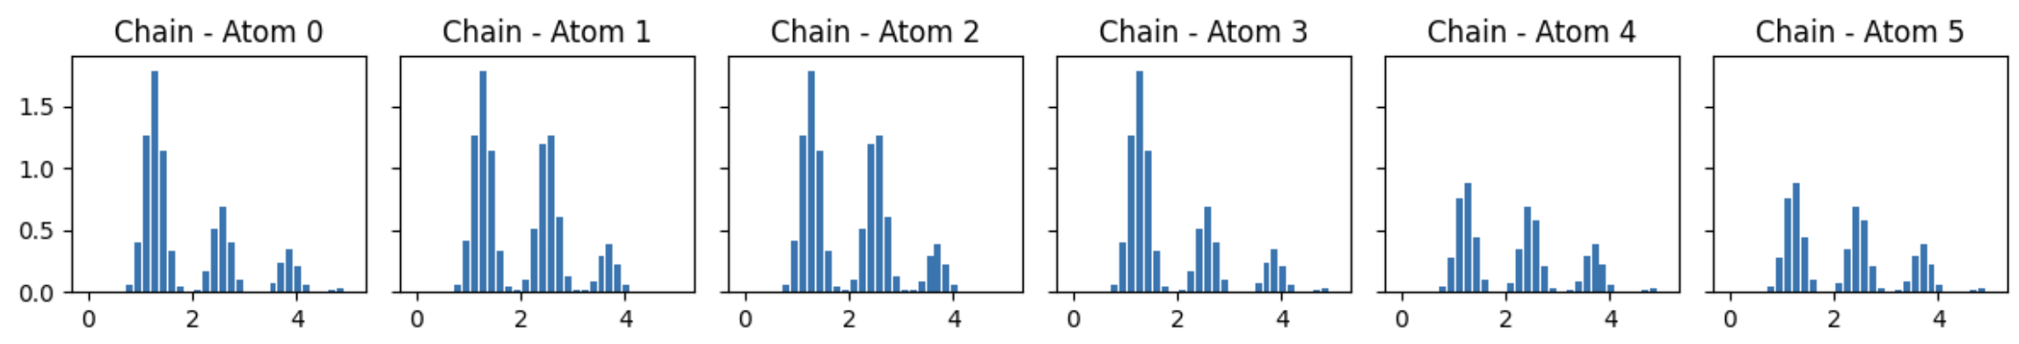
Local descriptors

Slide 4
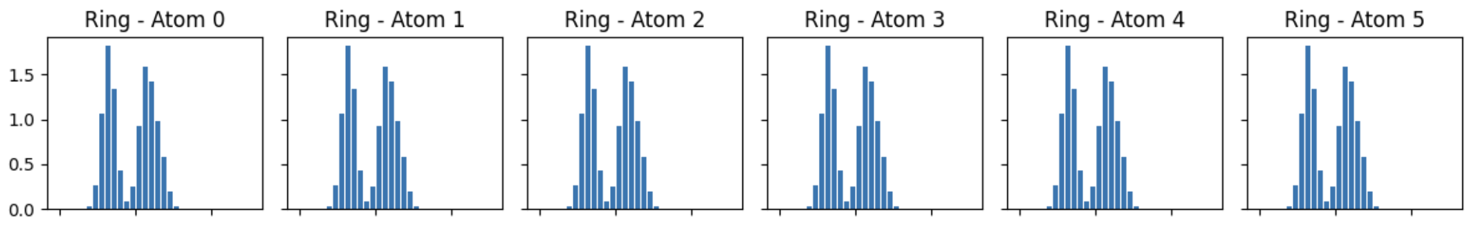
Local descriptors

Slide 5
Local descriptors

Slide 6
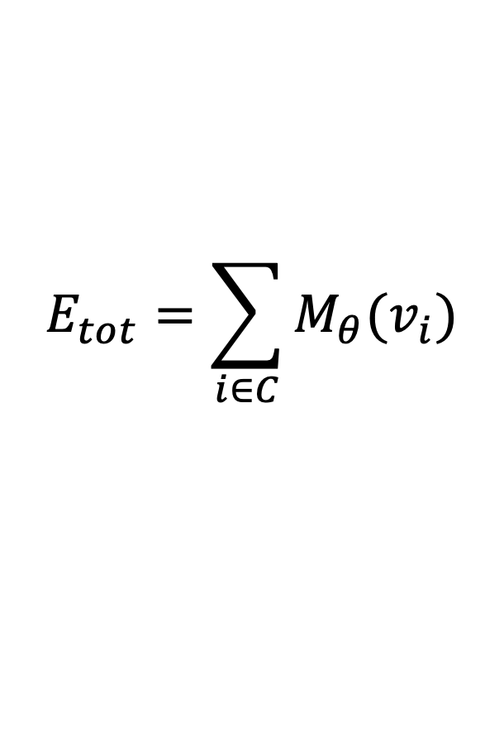
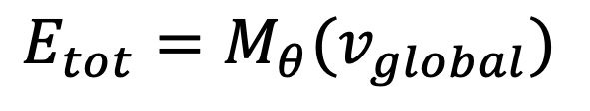
Global vs. local models
With global descriptors we model the total energy of a configuration in the straight forward way.
$$E_{tot}=M_{θ}(v_{global})$$
In a local model, we can model the total property as a function of atomic contributions
$$E_{tot}=\sum_{i∈C}{M_{θ}(v_{i})}$$
Where each $v_{i}$ is a local descriptor of an atom in configuration C.

Slide 7
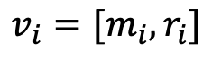
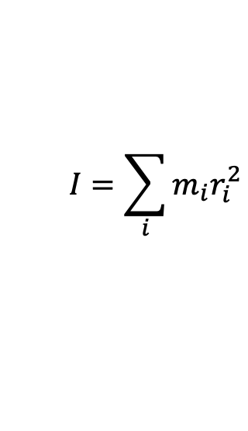
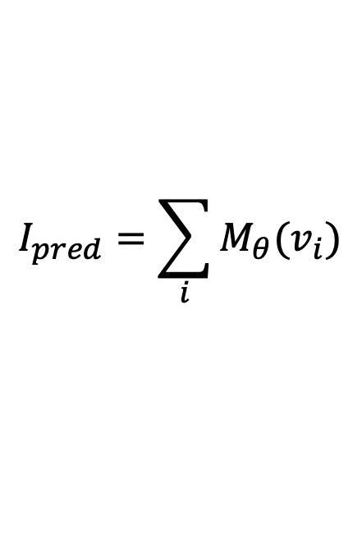
Example: Moment of Inertia
From mechanics we know that the moment of inertia is given by
Example with two weights.
$$I=\sum_{i}{m_{i}r_{i}^{2}}$$
Lets say that as local descriptors of this we have
$$v_{i}=[m_{i}, r_{i}]$$
Given observations of the total moment of inertia, the model needs to learn to model individual contributions.
We can then make a model where
$$I_{pred}=\sum_{i}{M_{θ}(v_{i})}$$

Slide 8
Convolutional local features.
One-hot representation (of the full configuration / state).
Atomic configuration
Discretization

Slide 9
Convolutional local features.
One-hot representation (of the full configuration / state).
Convolution operation
Kernel
0 | 1 | 0 | 1 | 0
1 | 2 | 1 | 2 | 0
0 | 3 | 0 | 3 | 0
1 | 2 | 1 | 2 | 0
1 | 2 | 1 | 1 | 0
0 | 1 | 0 | 1 | 0
1 | 2 | 1 | 2 | 0
0 | 3 | 0 | 3 | 0
1 | 2 | 1 | 2 | 0
1 | 2 | 1 | 1 | 0

Slide 10
Convolutional local features.
One-hot representation (of the full configuration / state).
Convolution operation
 |  |  |  | 1
Kernel
0 | 1 | 0 | 1 | 0
1 | 2 | 1 | 2 | 0
0 | 3 | 0 | 3 | 0
1 | 2 | 1 | 2 | 0
1 | 2 | 1 | 1 | 0
This is a feature vector with 1 feature

Slide 11

Convolutions & Features
Consider an atomic density function
Centered at some point in space.
$$ρ\left(r\right)=∑δ(r_{i}−r)$$
$$ρ\left(r\right)$$
$$r$$

Slide 12
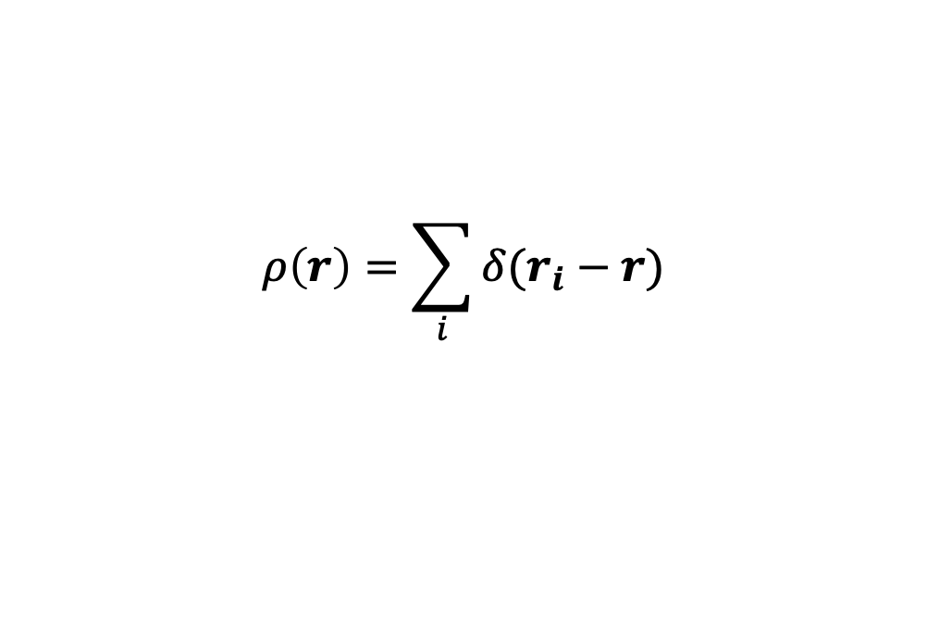
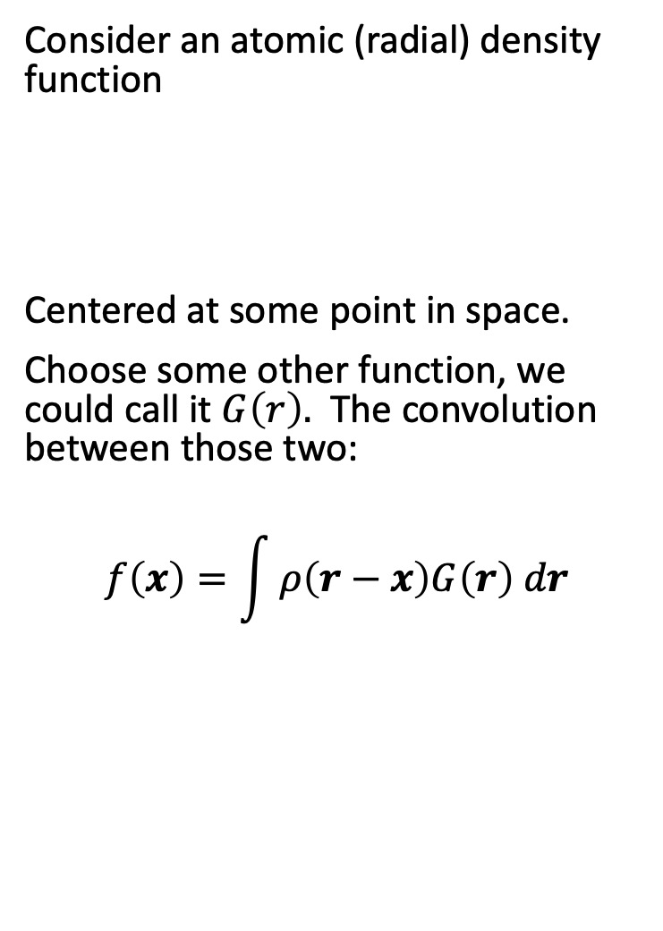


Convolutions & Features
Consider an atomic (radial) density function
Centered at some point in space.
Choose some other function, we could call it $G\left(r\right).$ The convolution between those two:
$$f\left(x\right)=\int{ρ\left(r−x\right)G\left(r\right) dr}$$
$$ρ\left(r\right)=\sum_{i}{δ(r_{i}−r)}$$
$$ρ\left(r\right)$$
$$r$$
$$G\left(r\right)$$
$$r$$

Slide 13
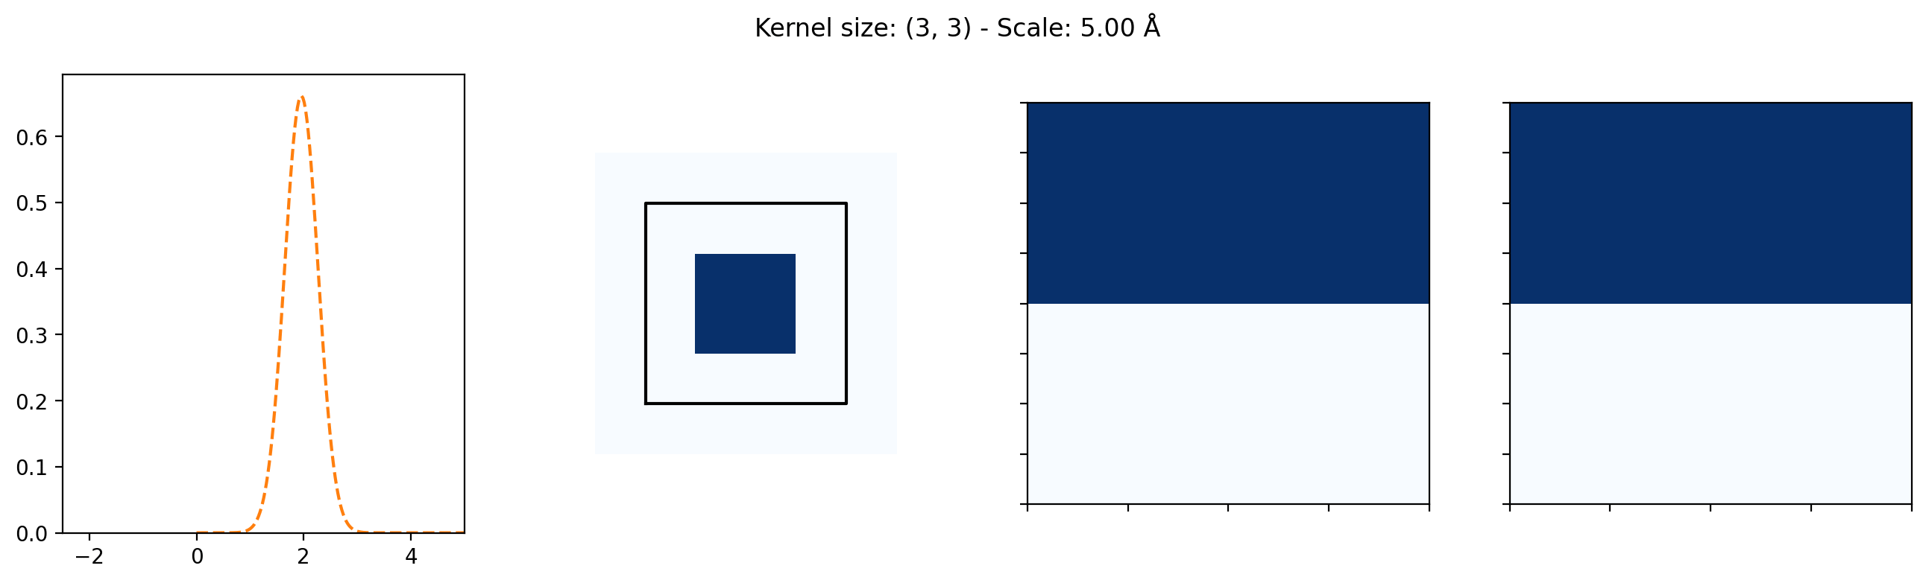
Convolutions and features.

Slide 14
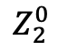
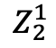
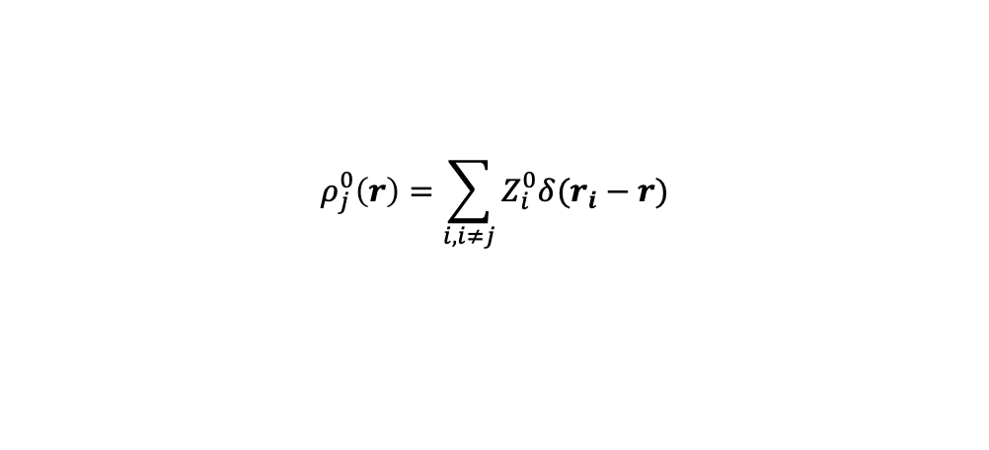
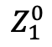
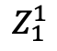
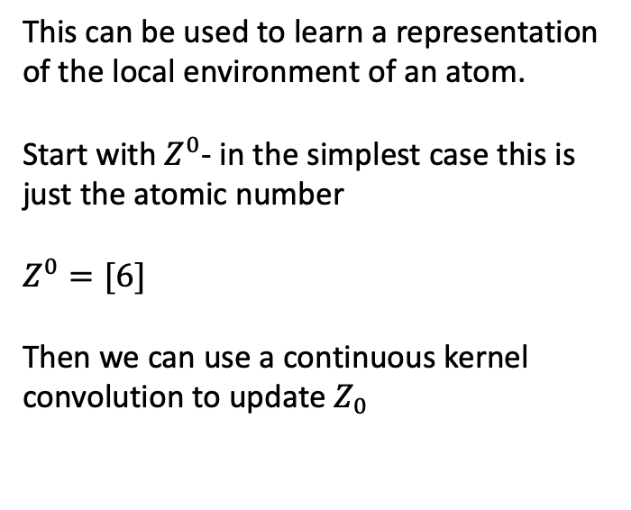
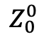
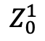
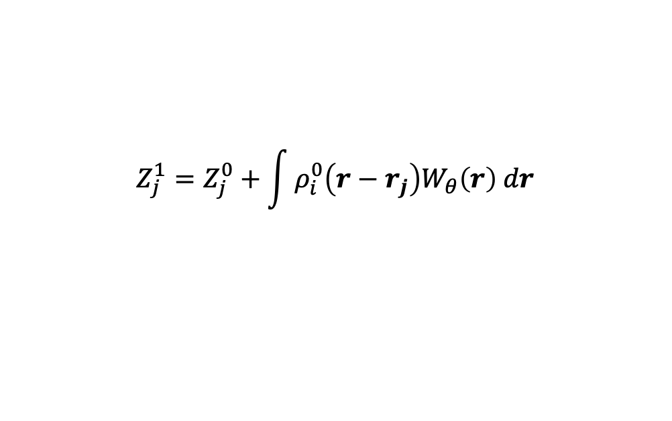
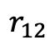
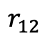
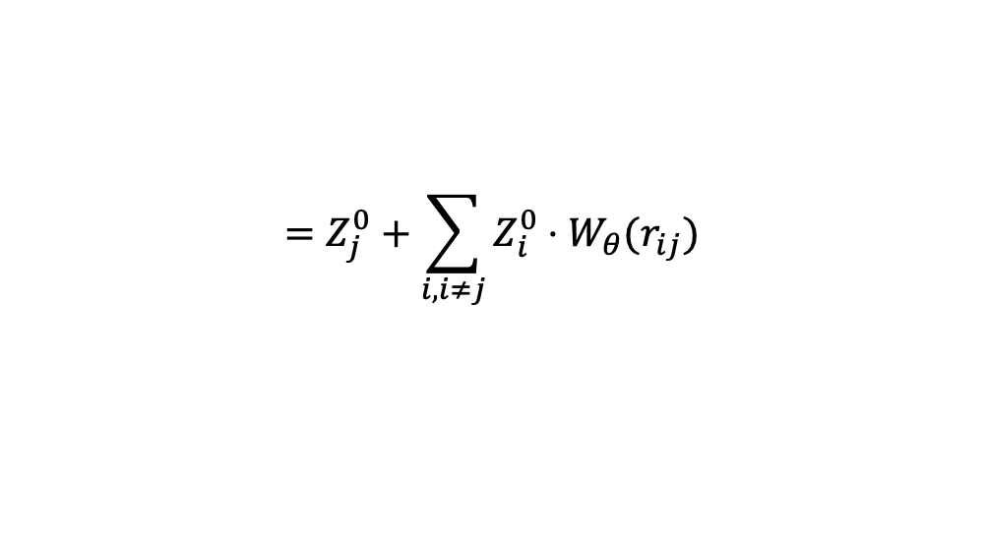
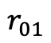
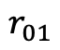
Learning continuous kernels
Initial descriptions – Just the atomic number
This can be used to learn a representation of the local environment of an atom.
Start with $Z^{0}$- in the simplest case this is just the atomic number
$Z^{0}=[6]$
Then we can use a continuous kernel convolution to update $Z_{0}$
$$Z_{0}^{0}$$
$$Z_{2}^{0}$$
$$Z_{1}^{0}$$
$$r_{01}$$
$$r_{12}$$
$$ρ_{j}^{0}\left(r\right)=\sum_{i,i≠j}{Z_{i}^{0}δ(r_{i}−r)}$$
Updated description – Depends on the neighborhood
$$Z_{0}^{1}$$
$$Z_{2}^{1}$$
$$Z_{j}^{1}=Z_{j}^{0}+\int{ρ_{i}^{0}\left(r−r_{j}\right)W_{θ}\left(r\right) dr}$$
$$Z_{1}^{1}$$
$$=Z_{j}^{0}+\sum_{i,i≠j}{Z_{i}^{0}⋅W_{θ}(r_{ij})}$$
$$r_{01}$$
$$r_{12}$$
The ‘effective species of an atom depends on its environment.

Slide 15
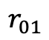
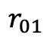
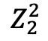
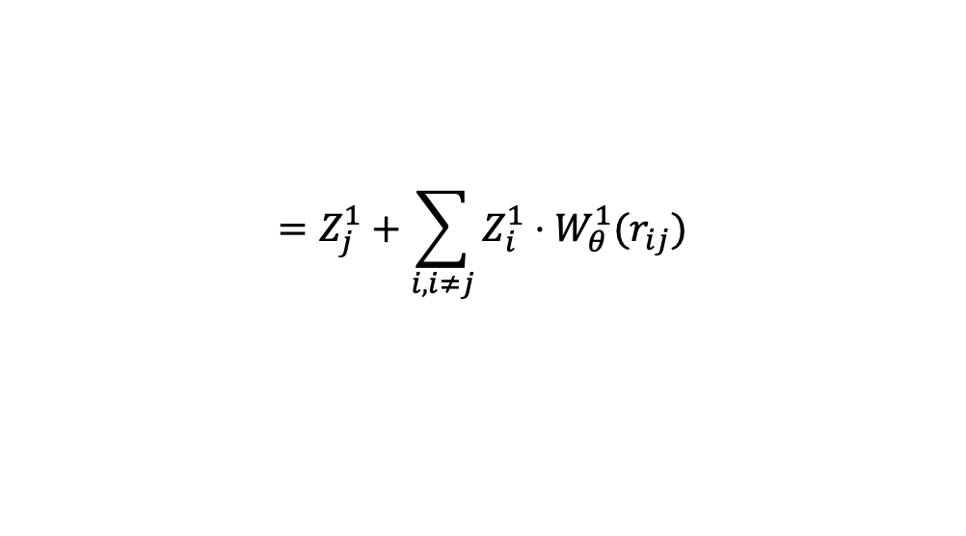
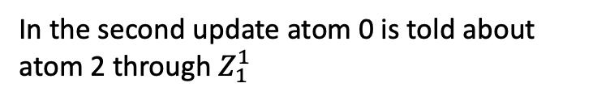
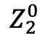
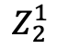
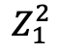
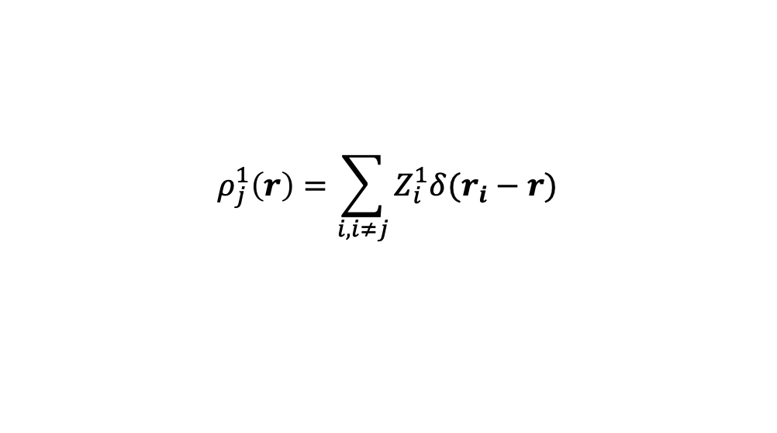
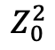
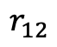
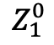
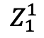
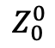
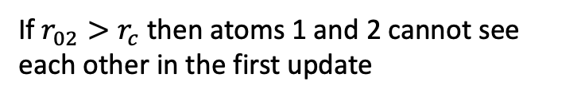
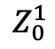
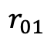
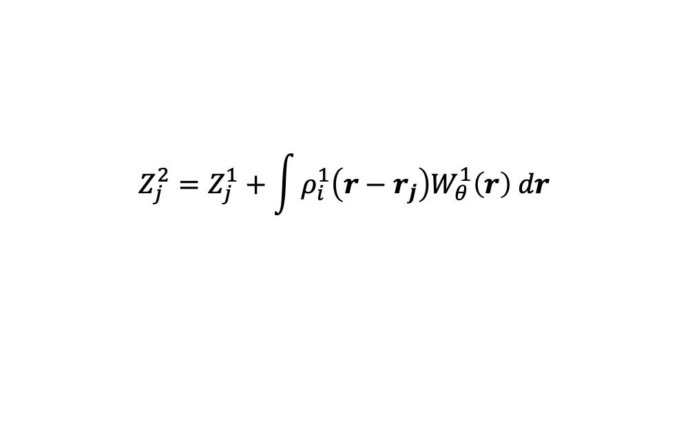
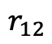
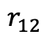
Multiple updates
$$Z_{0}^{0}$$
$$Z_{2}^{0}$$
$$Z_{1}^{0}$$
$$r_{01}$$
$$r_{12}$$
We can easily make more updates, its just a matter a different density function with a different kernel/filter.
If $r_{02}>r_{c}$ then atoms 1 and 2 cannot see each other in the first update
$$ρ_{j}^{1}\left(r\right)=\sum_{i,i≠j}{Z_{i}^{1}δ(r_{i}−r)}$$
$$Z_{0}^{1}$$
$$Z_{2}^{1}$$
$$Z_{1}^{1}$$
$$Z_{j}^{2}=Z_{j}^{1}+\int{ρ_{i}^{1}\left(r−r_{j}\right)W_{θ}^{1}\left(r\right) dr}$$
$$r_{01}$$
$$r_{12}$$
$$=Z_{j}^{1}+\sum_{i,i≠j}{Z_{i}^{1}⋅W_{θ}^{1}(r_{ij})}$$
In the second update atom 0 is told about atom 2 through $Z_{1}^{1}$
$$Z_{0}^{2}$$
$$Z_{2}^{2}$$
$$Z_{1}^{2}$$
$$r_{01}$$
$$r_{12}$$

Slide 16
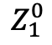
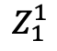
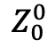
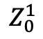








Vector representations.
Initial descriptions – vector that depends on the atomic number
$$Z_{0}^{0}$$
$$Z_{2}^{0}$$
Instead of the atomic number we can start with a vector.
Then the convolution becomes an element-wise product:
So now there’s a filter pr. dimension.
$$Z_{1}^{0}$$
$$Z_{j}^{0}=f_{θ}(Z_{j})$$
$$r_{01}$$
$$r_{12}$$
$$Z_{j}=Z_{j}^{0}+\sum_{i,i≠j}{Z_{i}^{0}⊙W_{θ}^{0}(r_{ij})}$$
Updated description – Depends on the neighborhood
$$⊙$$
$$=$$
$$Z_{0}^{1}$$
$$Z_{2}^{1}$$
$$Z_{1}^{1}$$
$$r_{01}$$
$$r_{12}$$
The vector-species of an atom depends on its environment.

Slide 17


Slide 18


Graphs

Slide 19

Graphs
Graph
Adjacency matrix

Slide 20

Social network graphs

Slide 21

Atomic Graphs

Slide 22


Message Passing
Message passing update
Graph

Slide 23










Message Passing on Atomic Graphs.
$$Z_{2}^{0}$$
Message Passing
$$Z_{2}^{1}$$
$$Z_{0}^{0}$$
$$Z_{0}^{1}$$
$$Z_{1}^{0}$$
$$Z_{1}^{1}$$
$$r_{01}$$
$$r_{12}$$
$$r_{01}$$
$$r_{12}$$

Slide 24

Examples: Phases of ice

Slide 25

Examples: Salt dissolution

Slide 26

Examples: Amorphous (112,000 atoms)
Radial Distribution function
Angular Distribution function

Slide 27

SchNet architecture.

Slide 28


SchNet architecture.
Atom-wise is a feature recombination layer
$$\hat{Z}=a(Z⋅W^{T}+b)$$
Cfconv is the continuous convolution with a learnable filter:
$$Z_{j}=Z_{j}^{0}+\sum_{i,i≠j}{Z_{i}^{0}⊙W_{θ}^{0}(r_{ij})}$$

Slide 29
SchNet architecture.
Multiple message passing layers.
A standard local ansatz to predict local energies.

